Slide 1
Lecture- 5 Mission Vision and Career

Slide 2

Understanding Mission & Vision
A mission statement is a concise explanation of the organization's reason for existence. It describes the organization's purpose and its overall intention
The mission statement supports the vision and serves to communicate purpose and direction to employees, customers, vendors and other stakeholders

Slide 3
Understanding Mission & Vision
A vision statement looks forward and creates a mental image of the ideal state that the organization wishes to achieve. It is inspirational and aspirational and should challenge employees
Questions to consider when drafting vision statements might include
What problem are we seeking to solve?
Where are we headed?
If we achieved all strategic goals, what would we look like 10 years from now?

Slide 4
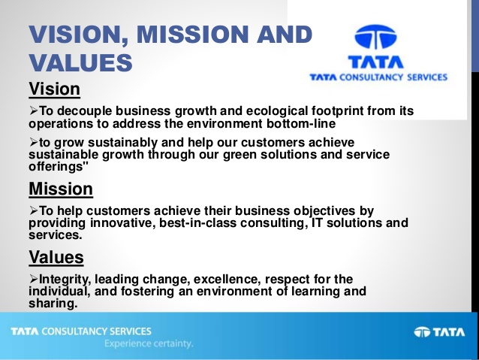
Example: Amazon’s vision and mission

Slide 5

Career
Simply known as an occupation undertaken for a significant period of a person's life and with opportunities for progress.
It defines your professional personality
It talks about what you have achieved professionally
A successful career needs thorough planning
The planning it starts TODAY!

Slide 6
Must Read
https://www.indeed.com/career-advice/resumes-cover-letters/write-mission-statement#:~:text=Personal%20mission%20statements%20are%20brief,help%20you%20reach%20your%20goals.

